Slide 1

ARTIFICIAL INTELLIGENCE & MACHINE LEARNING
SESSION NO : 8
Heuristic Search
Hill climbing, variants.

Slide 2
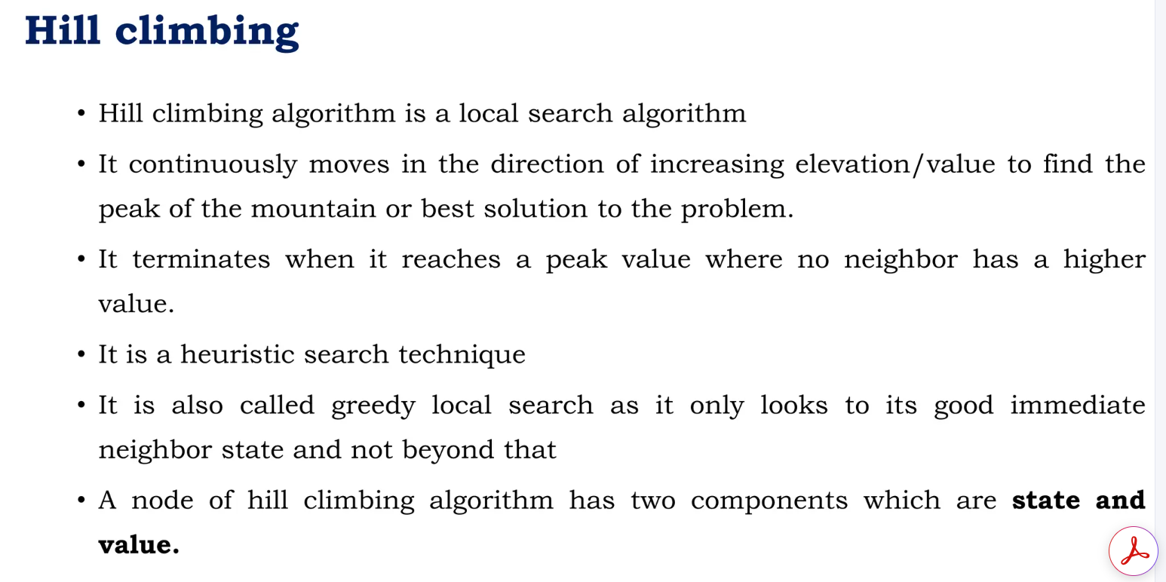

Slide 3
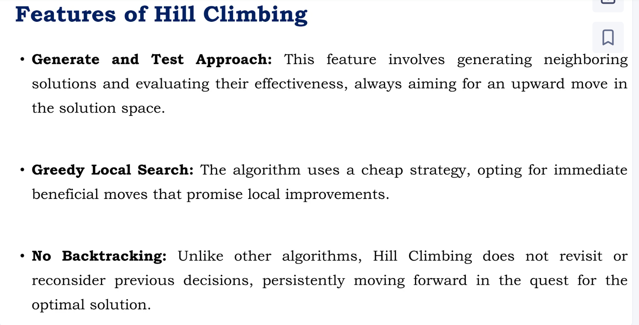

Slide 4
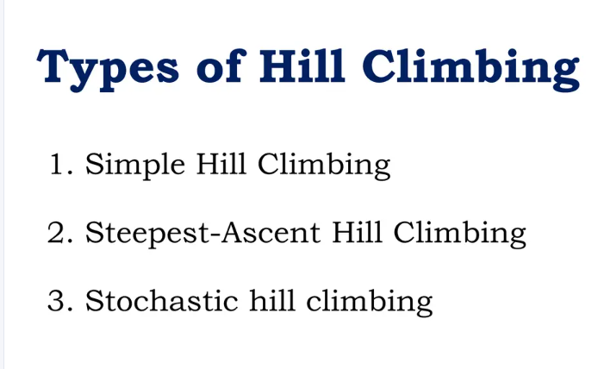

Slide 5
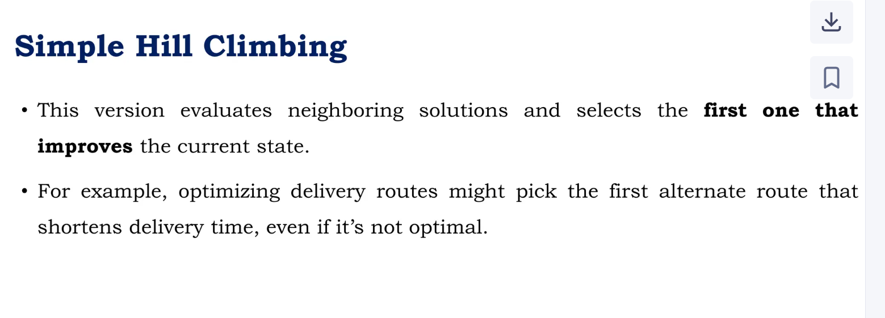

Slide 6
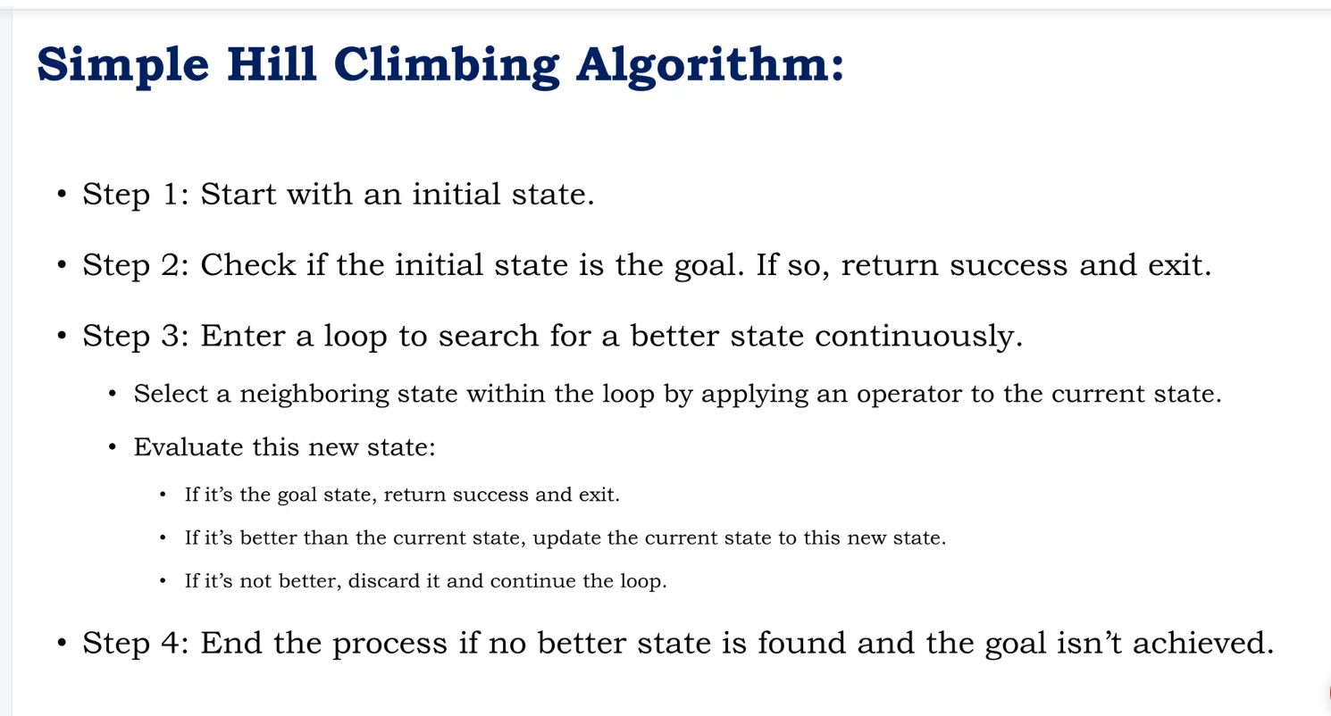

Slide 7
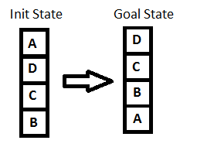
BLOCKs WORLD PROBLEM
The most important step in solving any hill-climbing issue is to pick the right heuristic function.
Definition of such a function, h
If the block is appropriately positioned, h(x) = +1 for all the blocks in the support structure; otherwise, h(x) = -1 for all the blocks in the support structure.

Slide 8
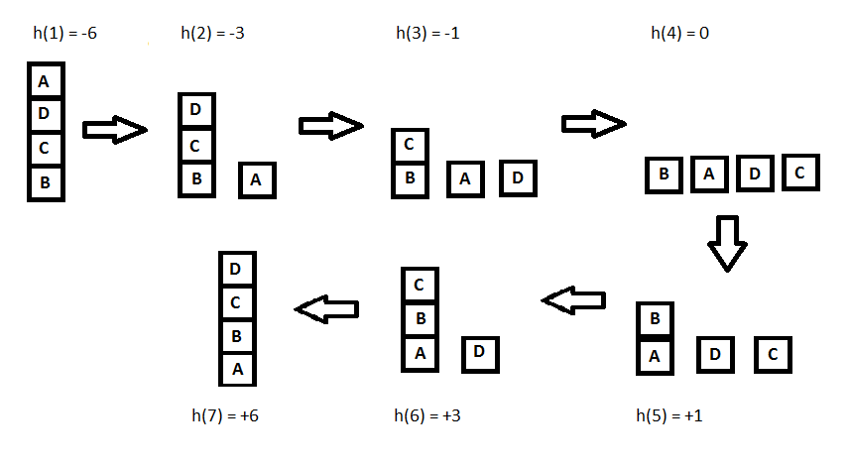
Any block that has the same support structure as the objective state is referred to in this context as being appropriately positioned. Let's have a look at all the iterations and their heuristics to achieve the goal state using the hill climbing approach we outlined earlier:
Example:
https://www.youtube.com/watch?v=2SlO34_VsY4

Slide 9
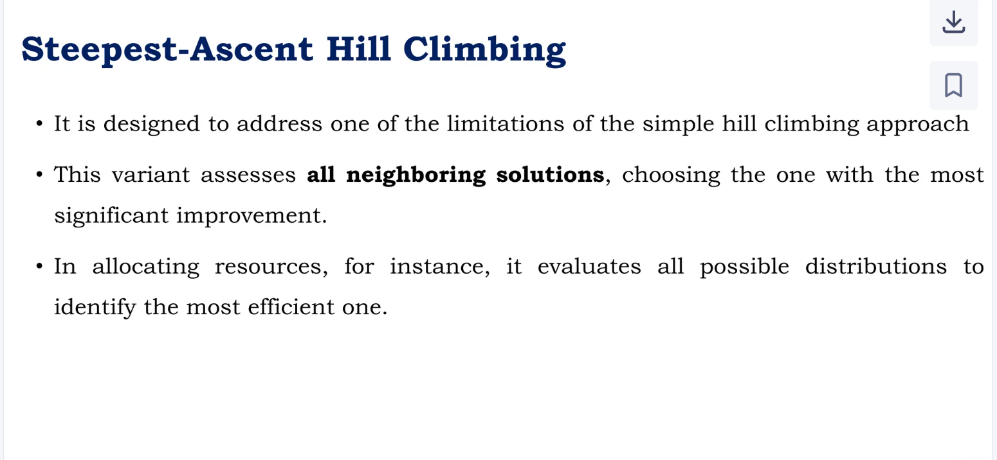

Slide 10
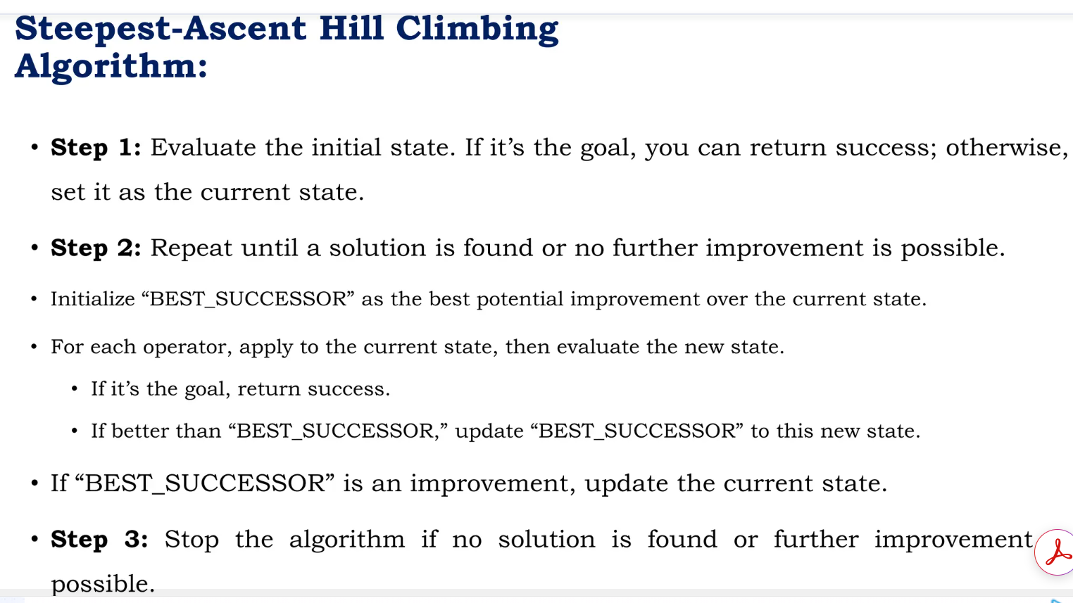

Slide 11
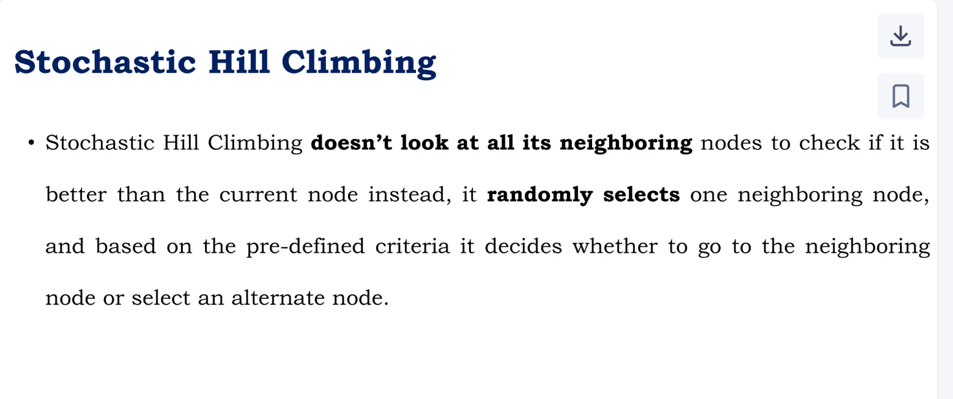

Slide 12
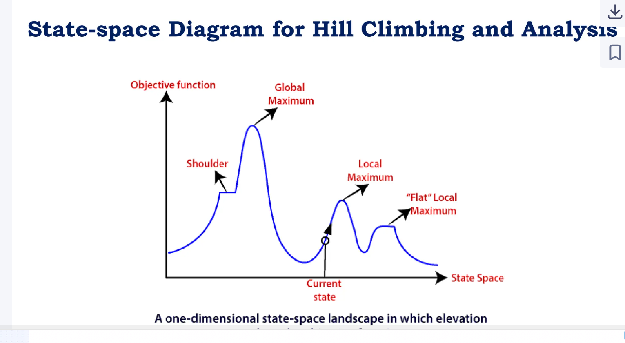

Slide 13
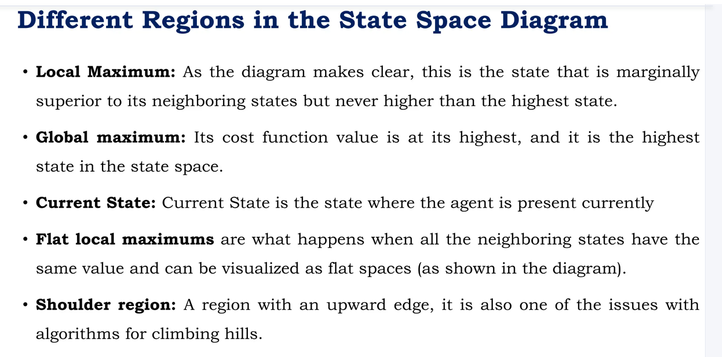

Slide 14
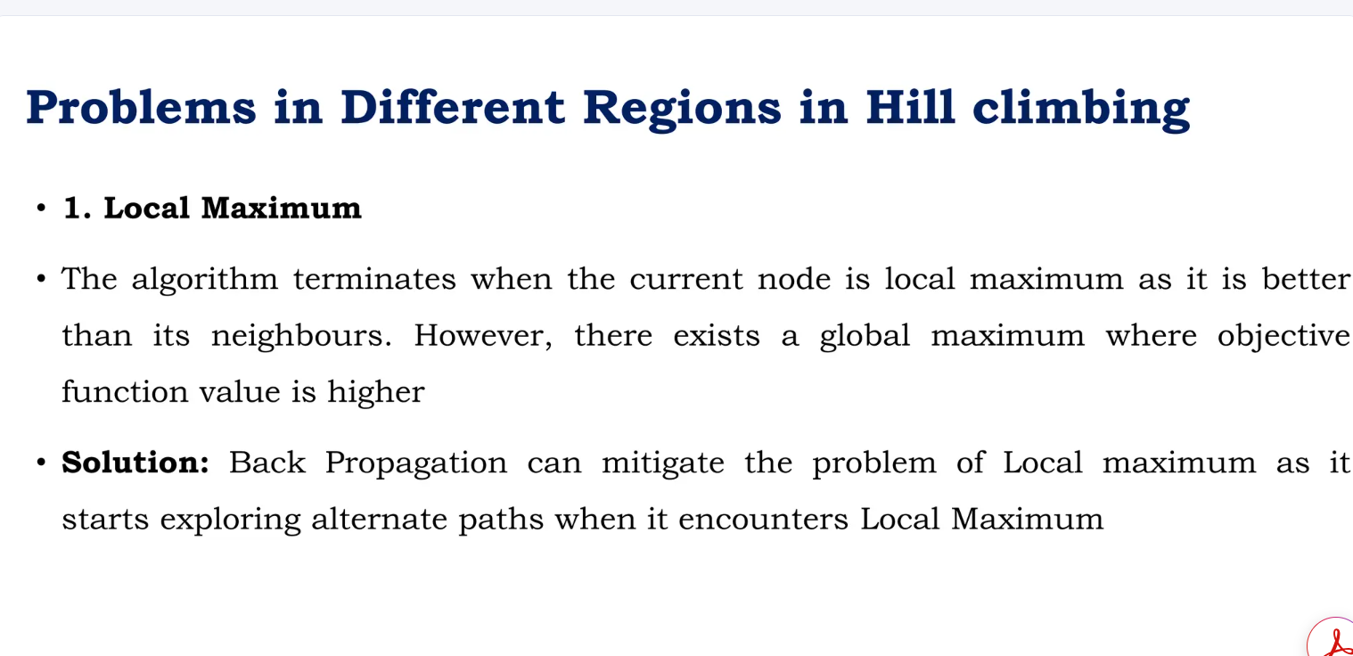

Slide 15
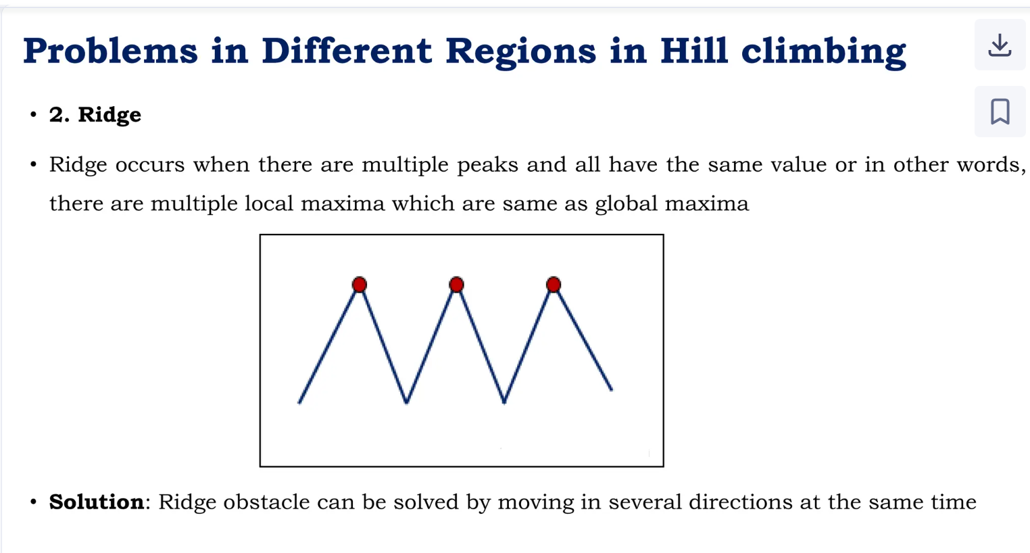

Slide 16
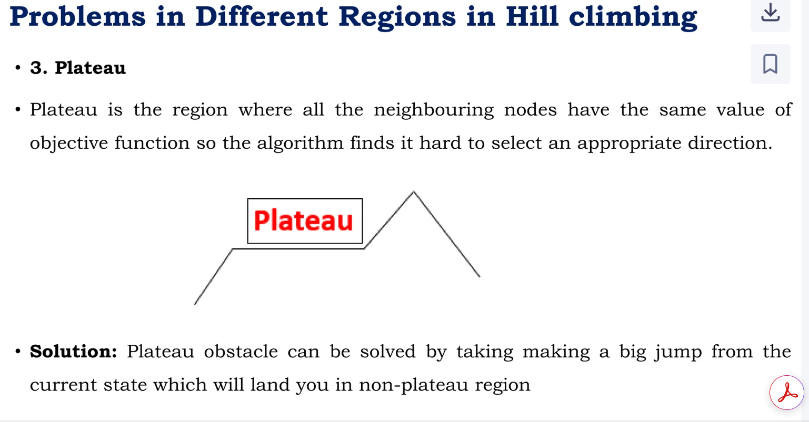

Slide 17
SIMULATED ANNEALING
Simulated Annealing is a modified version of stochastic hill climbing.
It is a heuristic search algorithm applied to achieve optimization in artificial intelligence issues.
It explores the search space and avoids local optimum by employing a probabilistic method to accept a worse solution with a given probability.
In simulated annealing, "temperature" is a parameter that controls the probability of accepting worse solutions as the algorithm progresses. It is analogous to the temperature in the physical annealing process where materials are heated and then slowly cooled to remove defects and find a low-energy state.
Example:
https://www.youtube.com/watch?v=uK6nbn7hArQ

Slide 18
SIMULATED ANNEALING
Key Points about Temperature in Simulated Annealing:
High Temperature: At the start, the temperature is set high, allowing the algorithm to accept worse solutions with higher probability. This helps in exploring the solution space more thoroughly and avoids getting trapped in local optima.
Cooling Schedule: The temperature is gradually reduced according to a cooling schedule. This schedule dictates how quickly the temperature decreases over time.
Low Temperature: As the temperature decreases, the probability of accepting worse solutions decreases, allowing the algorithm to converge to an optimal or near-optimal solution.

Slide 19
steps of the simulated annealing algorithm
Start with an initial solution.
Set the initial temperature to a high value.
Repeat the following steps until the stopping criterion is met:
Generate a new solution by making a small modification to the current solution.
Evaluate the objective function of the new solution.
If the new solution improves the objective function, accept it as the new current solution.
If the new solution does not improve the objective function, accept it with a probability that depends on the difference between the objective function values of the current and new solutions and the current temperature.
Decrease the temperature according to a cooling schedule.

Slide 20
steps of the simulated annealing algorithm
Return the current solution as the final solution.
The main principle of the simulated annealing algorithm is to control the level of randomness in the search process by altering the temperature parameter.
High temperatures enable the algorithm to explore new regions of the search space by increasing its propensity to accept non-improving moves. The algorithm becomes more selective and concentrates on improving the solution as the temperature drops.
Simulated annealing has been successfully applied to a wide range of optimization problems, such as the traveling salesman problem, the vehicle routing problem, and the job shop scheduling problem. However, it requires careful tuning of the temperature and cooling schedule parameters to achieve good performance.

Slide 21
Travelling Salesman Problem
The Traveling Salesman Problem (TSP) is a well-known example of a combinatorial optimization problem in which the goal is to determine the quickest path between the starting city and a given set of cities. No known algorithm can complete it in polynomial time because it is an NP-hard problem.
Local search algorithms for the TSP work by starting with an initial solution and incrementally improving it by making small changes to it one at a time until no more advancements are possible.
The probability P = exp(-ΔE/T)

Slide 22
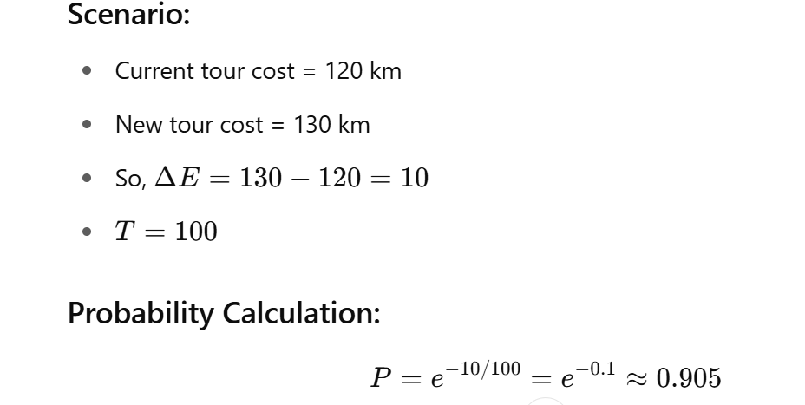

Slide 23
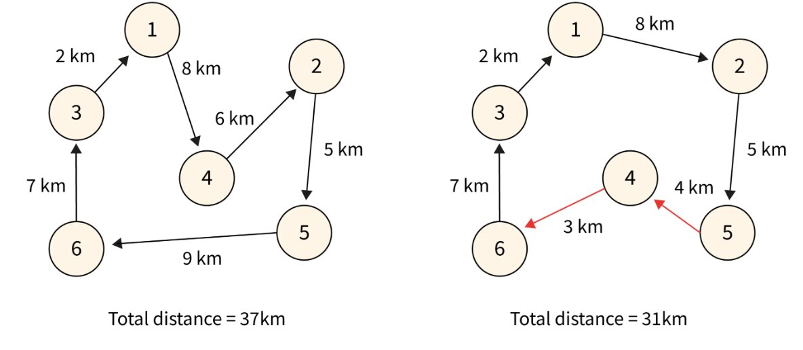
Travelling Salesman Problem

Slide 24
summary
Local search algorithms iteratively improve a single solution by making small modifications.
Local search algorithms are often simple and efficient and can handle large solution spaces.
However, they are prone to get stuck in local optima, where the solution is not the global optimum.
To overcome this limitation, various modifications to local search algorithms have been proposed, such as tabu search, simulated annealing, and genetic algorithms.

Slide 25
